Slide 1





MY INTERNSHIP IN PORTUGAL
aka my expectations & desires

Slide 2

WHY WOULD I LIKE TO LEARN IN PORTUGAL?

Slide 3




1.KNOWLEDGE
I think that gaining knowledge - especially at young age - is quite important for starting secure career in adult life. Studying abroad seems more convincing and mature for employers.

Slide 4


2.IMPROVING LANGUAGE SKILLS
Although I find my English skills decent, I’d like to improve them and correct my pronunciation. Talking with foreigners on daily basis may be the key to achieve that goal. It may also be an opportunity to learn another language - Portugese.

Slide 5

3.MEETING PEOPLE
Even simple actions like - for example - asking for directions may result in a new friendship that might last for years. Also having acquaintances in foreign countries expands our perception about the world and helps us with learning new things.

Slide 6


4.PERSONAL ASPECT
I’ve been fan of Portugal for quite some time. The thing that got me the most was azulejus and portugese songs. - especially tradicional fado music.

Slide 7


WHAT DO I WANT TO SEE/TRY WHILE ON INTERNSHIP?

Slide 8


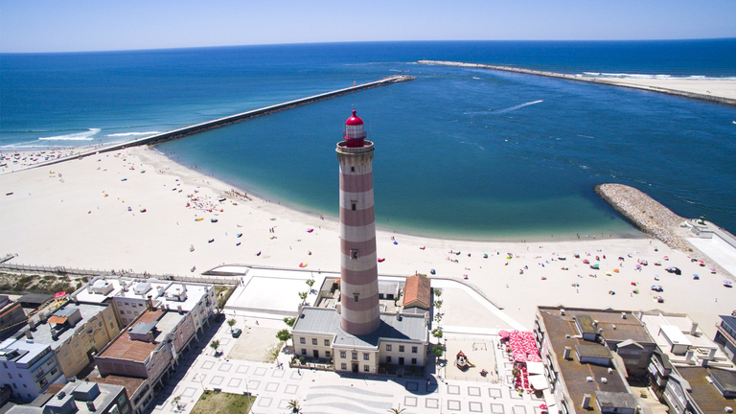

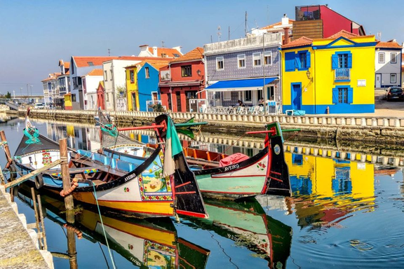
PLACES I’D LIKE TO SEE
Porto
Ílhavo
Lisbon
Aveiro

Slide 9



SIGHTS/TOURIST ATTRACTIONS
Monastery of Alcobaca
Benagil Caves
Cabo Girao Cliff

Slide 10





FOOD & DRINKS
I’d like to experience Portugese cafe culture
Eating Pastéis de nata on work breaks would make me feel like on holidays
Bifanas would make me full for whole day of sightseeing!
Pão de ló - simple but delicious. Best choice for desserts lovers.

Slide 11


YELLOW TRAINS
Yellow trams are unique and symbolic part of Lisbon. Even though they were constructed in early 30-s’, they are still appearing to be an extremely popular city transport. It may not seem like unusual expirience but vibes will definitely pay off.

Slide 12



,,NOTHING EVER BECOMES REAL TILL IT IS EXPERIENCED.’’
John Keats

Slide 13




THANK YOU!
made by Turska Zuzanna 3TWc

